Slide 1

Slides for Chapter 11:
Security
From Coulouris, Dollimore, Kindberg and Blair
Distributed Systems:
Concepts and Design
Edition 5, © Addison-Wesley 2012

Slide 2
Figure 11.1
Familiar names for the protagonists in security protocols
Alice
First participant
Bob
Second participant
Carol
Participant in three- and four-party protocols
Dave
Participant in four-party protocols
Eve
Eavesdropper
Mallory
Malicious attacker
Sara
A server
Instructor’s Guide for Coulouris, Dollimore, Kindberg and Blair, Distributed Systems: Concepts and Design Edn. 5
© Pearson Education 2012

Slide 3
Figure 11.2
Cryptography notations
K_{A}
Alice’s secret key
K_{B}
Bob’s secret key
K_{AB}
Secret key shared between Alice and Bob
K_{Apriv}
Alice’s private key (known only to Alice)
K_{Apub}
Alice’s public key (published by Alice for all to read)
{
M
}
_{K}
Message
M
encrypted with key
K
[
M
]_{K}
Message
M
signed with key
K
Instructor’s Guide for Coulouris, Dollimore, Kindberg and Blair, Distributed Systems: Concepts and Design Edn. 5
© Pearson Education 2012

Slide 4
Figure 11.3
Alice’s bank account certificate
1.
Certificate type
:
Account number
2.
Name
:
Alice
3.
Account
:
6262626
4.
Certifying authority
:
Bob’s Bank
5.
Signature
:
{Digest(field 2 + field 3)}
K_{Bpriv}
Instructor’s Guide for Coulouris, Dollimore, Kindberg and Blair, Distributed Systems: Concepts and Design Edn. 5
© Pearson Education 2012

Slide 5
Figure 11.4
Public-key certificate for Bob’s Bank
1.
Certificate type
:
Public key
2.
Name
:
Bob’s Bank
3.
Public key
:
K_{Bpub}
4.
Certifying authority
:
Fred – The Bankers Federation
5.
Signature
{Digest(field 2 + field 3)}
:
K_{Fpriv}
Instructor’s Guide for Coulouris, Dollimore, Kindberg and Blair, Distributed Systems: Concepts and Design Edn. 5
© Pearson Education 2012

Slide 6
Figure 11.5
Cipher block chaining
plaintext blocks
n+3
n+2
n+1
XOR
E(K, M)
ciphertext blocks
n-3
n-2
n-1
n
Instructor’s Guide for Coulouris, Dollimore, Kindberg and Blair, Distributed Systems: Concepts and Design Edn. 5
© Pearson Education 2012

Slide 7
Figure 11.6
Stream cipher
keystream
number
n+3
n+2
n+1
E(K, M)
buffer
generator
XOR
plaintext
ciphertext
stream
stream
Instructor’s Guide for Coulouris, Dollimore, Kindberg and Blair, Distributed Systems: Concepts and Design Edn. 5
© Pearson Education 2012

Slide 8
Figure 11.7
TEA encryption function
void encrypt(unsigned long k[], unsigned long text[]) {
unsigned long y = text[0], z = text[1]; 1
unsigned long delta = 0x9e3779b9, sum = 0; int n; 2
for (n= 0; n < 32; n++) { 3
sum += delta; 4
y += ((z << 4) + k[0]) ^ (z+sum) ^ ((z >> 5) + k[1]); 5
z += ((y << 4) + k[2]) ^ (y+sum) ^ ((y >> 5) + k[3]); 6
}
text[0] = y; text[1] = z; 7
}
Instructor’s Guide for Coulouris, Dollimore, Kindberg and Blair, Distributed Systems: Concepts and Design Edn. 5
© Pearson Education 2012

Slide 9
Figure 11.8
TEA decryption function
void decrypt(unsigned long k[], unsigned long text[]) {
unsigned long y = text[0], z = text[1];
unsigned long delta = 0x9e3779b9, sum = delta << 5; int n;
for (n= 0; n < 32; n++) {
z -= ((y << 4) + k[2]) ^ (y + sum) ^ ((y >> 5) + k[3]);
y -= ((z << 4) + k[0]) ^ (z + sum) ^ ((z >> 5) + k[1]);
sum -= delta;
}
text[0] = y; text[1] = z;
}
Instructor’s Guide for Coulouris, Dollimore, Kindberg and Blair, Distributed Systems: Concepts and Design Edn. 5
© Pearson Education 2012

Slide 10
Figure 11.9
TEA in use
void tea(char mode, FILE *infile, FILE *outfile, unsigned long k[]) {
/* mode is ’e’ for encrypt, ’d’ for decrypt, k[] is the key.*/
char ch, Text[8]; int i;
while(!feof(infile)) {
i = fread(Text, 1, 8, infile); /* read 8 bytes from infile into Text */
if (i <= 0) break;
while (i < 8) { Text[i++] = ' ';} /* pad last block with spaces */
switch (mode) {
case 'e':
encrypt(k, (unsigned long*) Text); break;
case 'd':
decrypt(k, (unsigned long*) Text); break;
}
fwrite(Text, 1, 8, outfile); /* write 8 bytes from Text to outfile */
}
}
Instructor’s Guide for Coulouris, Dollimore, Kindberg and Blair, Distributed Systems: Concepts and Design Edn. 5
© Pearson Education 2012

Slide 11
RSA Encryption - 1
To find a key pair e, d:
1. Choose two large prime numbers, P and Q (each greater than 10100), and form:
N = P x Q
Z = (P–1) x (Q–1)
2. For d choose any number that is relatively prime with Z (that is, such that d has no common factors with Z).
We illustrate the computations involved using small integer values for P and Q:
P = 13, Q = 17 –> N = 221, Z = 192
d = 5
3. To find e solve the equation:
e x d = 1 mod Z
That is, e x d is the smallest element divisible by d in the series Z+1, 2Z+1, 3Z+1, ... .
e x d = 1 mod 192 = 1, 193, 385, ...
385 is divisible by d
e = 385/5 = 77
Instructor’s Guide for Coulouris, Dollimore, Kindberg and Blair, Distributed Systems: Concepts and Design Edn. 5
© Pearson Education 2012

Slide 12
RSA Encryption - 2
To encrypt text using the RSA method, the plaintext is divided into equal blocks of length k bits where 2^{k} < N (that is, such that the numerical value of a block is always less than N; in practical applications, k is usually in the range 512 to 1024).
k = 7, since 27 = 128
The function for encrypting a single block of plaintext M is:
E'(e,N,M) = Me mod N
for a message M, the ciphertext is M⁷⁷ mod 221
The function for decrypting a block of encrypted text c to produce the original plaintext block is:
D'(d,N,c) = c^{d} mod N
Rivest, Shamir and Adelman proved that E' and D' are mutual inverses
(that is, E'(D'(x)) = D'(E'(x)) = x) for all values of P in the range 0 ≤ P ≤ N.
The two parameters e,N can be regarded as a key for the encryption function, and similarly d,N represent a key for the decryption function.
So we can write K_{e} = <e,N> and K_{d} = <d,N>, and we get the encryption function:
E(K_{e}, M) ={M}_{K} (the notation here indicating that the encrypted message can be decrypted only by the holder of the private key K_{d}) and D(K_{d}, ={M}_{K} ) = M.
Instructor’s Guide for Coulouris, Dollimore, Kindberg and Blair, Distributed Systems: Concepts and Design Edn. 5
© Pearson Education 2012

Slide 13
Figure 11.10
Digital signatures with public keys
Instructor’s Guide for Coulouris, Dollimore, Kindberg and Blair, Distributed Systems: Concepts and Design Edn. 5
© Pearson Education 2012

Slide 14
Figure 11.11
Low-cost signatures with a shared secret key
Instructor’s Guide for Coulouris, Dollimore, Kindberg and Blair, Distributed Systems: Concepts and Design Edn. 5
© Pearson Education 2012

Slide 15
Figure 11.12
X509 Certificate format
S
u
b
jec
t
D
i
s
t
i
n
g
u
is
he
d N
a
m
e,
Pu
b
l
ic
K
e
y
Iss
ue
r
D
i
s
t
i
n
g
u
is
he
d N
a
m
e,
Si
g
n
at
u
r
e
Pe
ri
o
d
o
f
v
a
li
d
i
t
y
N
o
t
Be
f
o
r
e
Da
t
e,
No
t
A
f
t
e
r
D
ate
A
d
m
i
ni
str
a
t
ive
i
n
fo
rma
ti
o
n
V
er
si
o
n
,
S
e
r
i
a
l
N
u
mb
e
r
Ex
t
en
d
e
d
I
n
f
or
m
a
t
i
o
n
Instructor’s Guide for Coulouris, Dollimore, Kindberg and Blair, Distributed Systems: Concepts and Design Edn. 5
© Pearson Education 2012

Slide 16
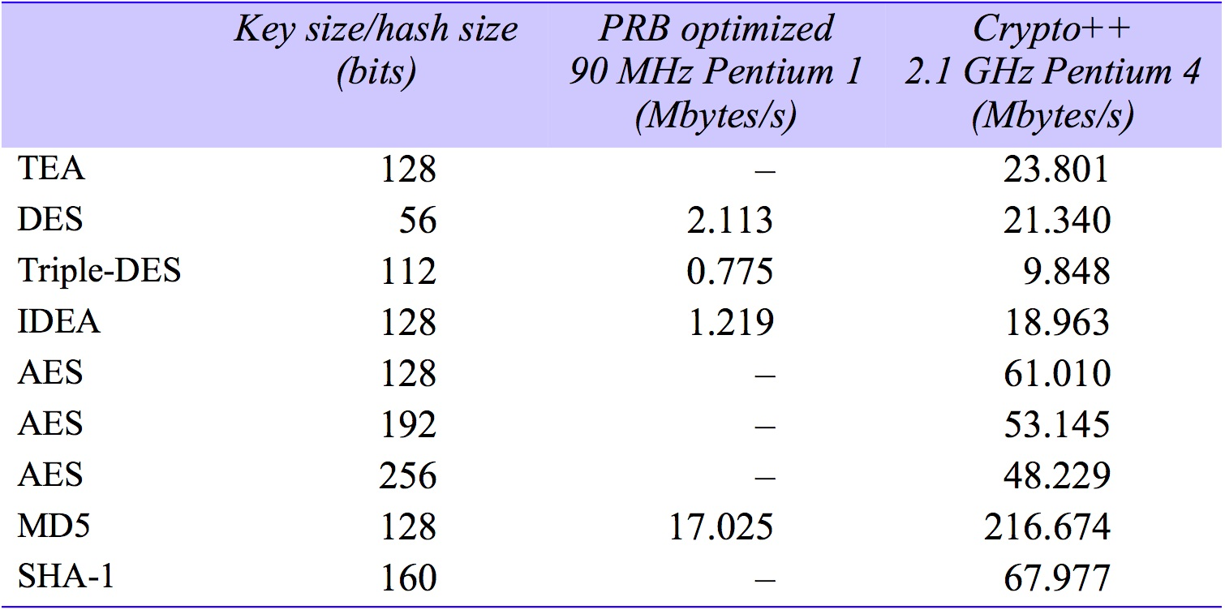
Figure 11.13
Performance of symmetric encryption and secure digest algorithms
Instructor’s Guide for Coulouris, Dollimore, Kindberg and Blair, Distributed Systems: Concepts and Design Edn. 5
© Pearson Education 2012

Slide 17
Figure 11.14
The Needham–Schroeder secret-key authentication protocol
Header
Message
Notes
1. A->S:
A, B, N_{A}
A requests S to supply a key for communication
with B.
2. S->A:
{N_{A} , B, K_{AB},
S returns a message encrypted in A’s secret key,
containing a newly generated key K_{AB} and a
{K_{AB}, A}_{KB}}_{KA}
‘ticket’ encrypted in B’s secret key. The nonce N_{A}
demonstrates that the message was sent in response
to the preceding one. A believes that S sent the
message because only S knows A’s secret key.
3. A->B:
{K_{AB}, A}_{KB}
A sends the ‘ticket’ to B.
4. B->A:
{N_{B}}_{KAB}
B decrypts the ticket and uses the new key K_{AB} to
encrypt another nonce N_{B}.
5. A->B:
{N_{B} - 1}_{KAB}
A demonstrates to B that it was the sender of the
previous message by returning an agreed
transformation of N_{B}.
Instructor’s Guide for Coulouris, Dollimore, Kindberg and Blair, Distributed Systems: Concepts and Design Edn. 5
© Pearson Education 2012

Slide 18
Figure 11.15
System architecture of Kerberos
Kerberos Key Distribution Centre
Authentication
Step A
database
Ticket-
Authen-
granting
1. Request for
tication
service T
TGS ticket
service A
2. TGS
ticket
Step B
3. Request for
server ticket
Login
4. Server ticket
Step C
session setup
5.
Service
Server
request
Service
Client
session setup
Server
C
Request encrypted with session key
function
S
DoOperation
Reply encrypted with session key
Instructor’s Guide for Coulouris, Dollimore, Kindberg and Blair, Distributed Systems: Concepts and Design Edn. 5
© Pearson Education 2012

Slide 19
Figure 11.16
SSL protocol stack
SSL
Handshake
SSL Change
SSL Alert
Cipher Spec
Protocol
HTTP
Telnet
protocol
SSL Record Protocol
Transport layer (usually TCP)
Network layer (usually IP)
SSL protocols:
Other protocols:
Instructor’s Guide for Coulouris, Dollimore, Kindberg and Blair, Distributed Systems: Concepts and Design Edn. 5
© Pearson Education 2012

Slide 20
Figure 11.17
TLS handshake protocol
Instructor’s Guide for Coulouris, Dollimore, Kindberg and Blair, Distributed Systems: Concepts and Design Edn. 5
© Pearson Education 2012

Slide 21
Figure 11.18
TLS handshake configuration options
Component
Description
Example
Key exchange
the method to be used for
RSA with public-key
method
exchange of a session key
certificates
Cipher for data
the block or stream cipher to be
IDEA
transfer
used for data
Message digest
for creating message
SHA-1
function
authentication codes (MACs)
Instructor’s Guide for Coulouris, Dollimore, Kindberg and Blair, Distributed Systems: Concepts and Design Edn. 5
© Pearson Education 2012

Slide 22
Figure 11.19
TLS record protocol
Application data
abcdefghi
Fragment/combine
Record protocol units
abc
def
ghi
Compress
Compressed units
Hash
MAC
Encrypt
Encrypted
Transmit
TCP packet
Instructor’s Guide for Coulouris, Dollimore, Kindberg and Blair, Distributed Systems: Concepts and Design Edn. 5
© Pearson Education 2012

Slide 23
Figure 11.20
Use of RC4 stream cipher in IEEE 802.11 WEP
Instructor’s Guide for Coulouris, Dollimore, Kindberg and Blair, Distributed Systems: Concepts and Design Edn. 5
© Pearson Education 2012

